Slide 1
OpenGL Installation
Computer Graphics Lab

Slide 2

Install Visual Studio

Slide 3

Click on Free download

Slide 4
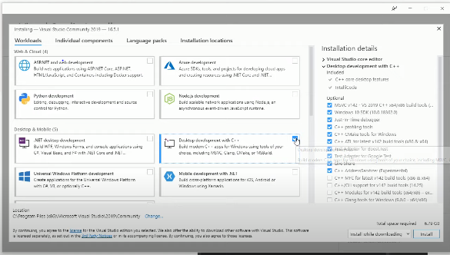
Tick Mark Desktop Development with C++

Slide 5
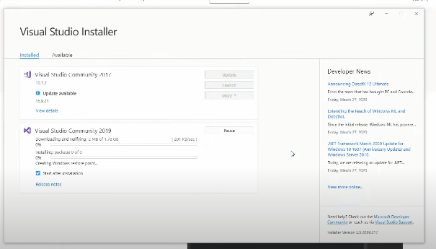
It will take few minutes to install

Slide 6
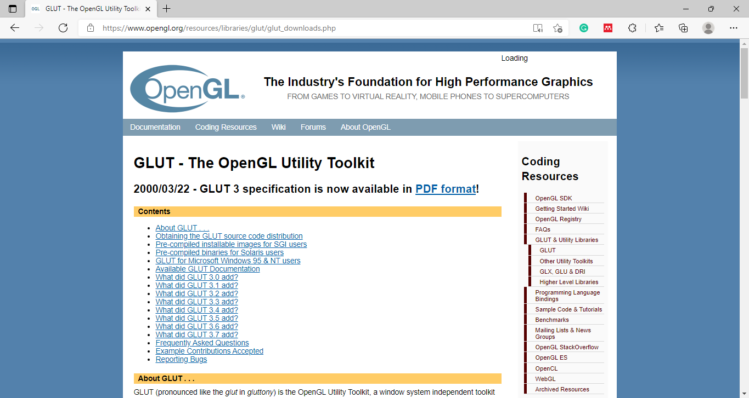
Download OpenGL

Slide 7
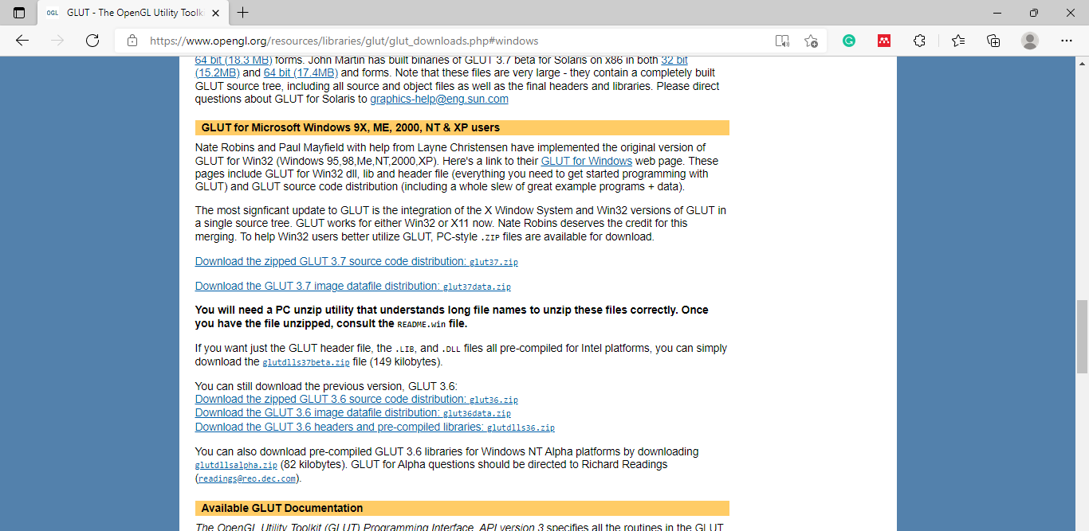
GLUT for Microsoft Windows

Slide 8
Download the zip file
https://www.opengl.org/resources/libraries/glut/glut_downloads.php

Slide 9
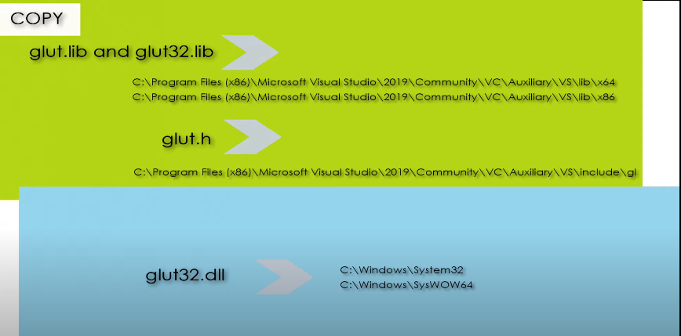
Copy required files to specific folders

Slide 10
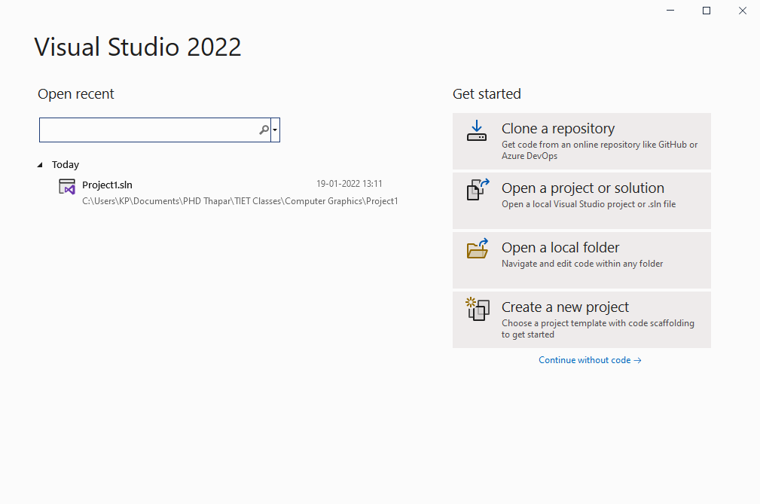
After installation click on create new project

Slide 11
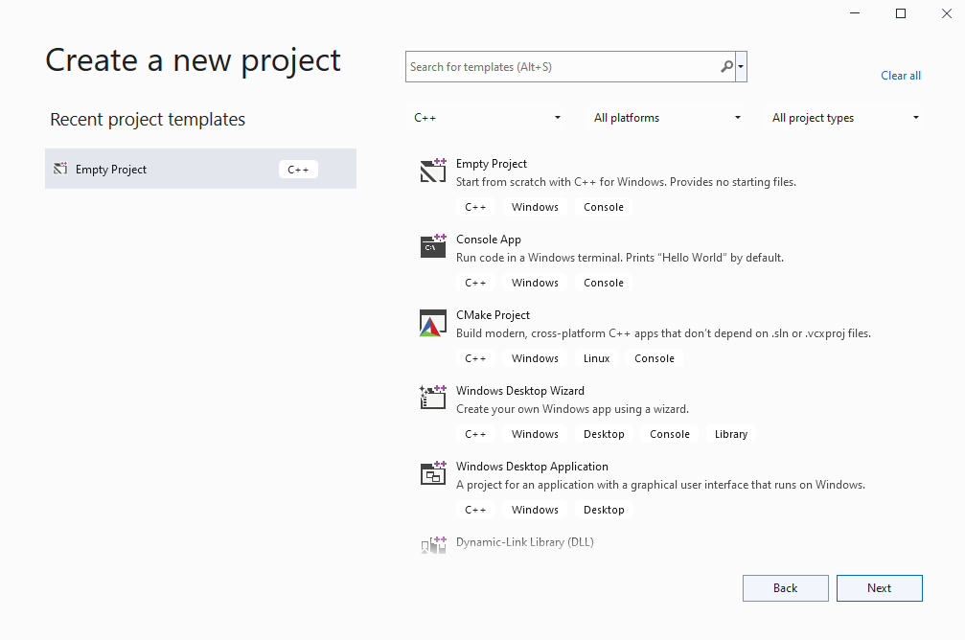
Click on empty project

Slide 12
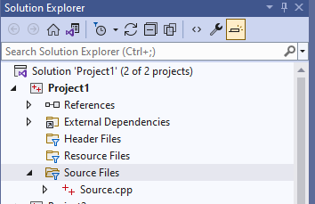
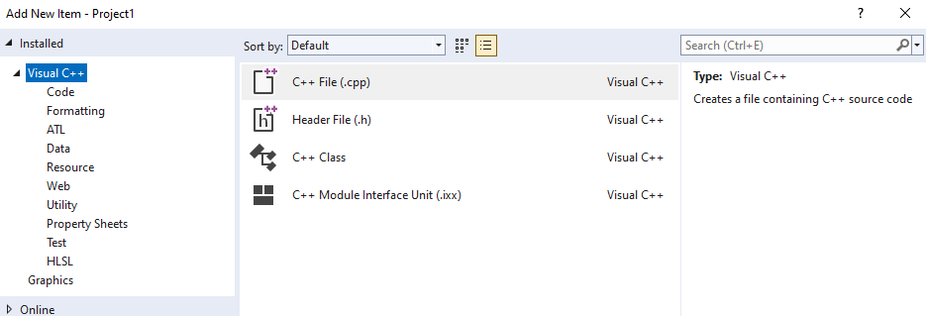
Right click on source File→ Add → new item→.cpp file

Slide 13
What is OpenGL ?
OpenGL is Open Graphics Library
Software interface → Graphics Hardware

Slide 14
3 sets of libraries in our OpenGL programs:
Core OpenGL (GL): consists of hundreds of commands, which begin with a prefix "gl" (e.g., glColor, glVertex, glTranslate, glRotate). The Core OpenGL models an object via a set of geometric primitives such as point, line and polygon.
OpenGL Utility Library (GLU): built on-top of the core OpenGL to provide important utilities (such as setting camera view and projection) and more building models (such as qradric surfaces and polygon tessellation). GLU commands start with a prefix "glu" (e.g., gluLookAt, gluPerspective).

Slide 15
3 sets of libraries in our OpenGL programs:
OpenGL Utilities Toolkit (GLUT): OpenGL is designed to be independent of the windowing system or operating system. GLUT is needed to interact with the Operating System (such as creating a window, handling key and mouse inputs); it also provides more building models (such as sphere and torus). GLUT commands start with a prefix of "glut" (e.g., glutCreatewindow, glutMouseFunc). GLUT is platform independent, which is built on top of platform-specific OpenGL extension such as GLX for X Window System, WGL for Microsoft Window, and AGL, CGL or Cocoa for Mac OS.

Slide 16
Sample Program
#include <GL/glut.h>
#include <GL/gl.h>
void main(int argc, char** argv)
{
int mode = GLUT_RGB|GLUT_DOUBLE;
glutInitDisplayMode( mode );
glutInitWindowSize( 500,500 );
glutCreateWindow( “Simple” );
init();
glutDisplayFunc( display );
glutKeyboardFunc( key );
glutMainLoop();
}

Slide 17
Sample Program
#include <GL/glut.h>
#include <GL/gl.h>
void main(int argc, char** argv)
{
int mode = GLUT_RGB|GLUT_DOUBLE;
glutInitDisplayMode( mode );
glutInitWindowSize( 500,500 );
glutCreateWindow( “Simple” );
init();
glutDisplayFunc( display );
glutKeyboardFunc( key );
glutMainLoop();
}
Specify the display
Mode – RGB or color
Index, single or double
Buffer

Slide 18
Sample Program
#include <GL/glut.h>
#include <GL/gl.h>
void main(int argc, char** argv)
{
int mode = GLUT_RGB|GLUT_DOUBLE;
glutInitDisplayMode( mode );
glutInitWindowSize( 500,500 );
glutCreateWindow( “Simple” );
init();
glutDisplayFunc( display );
glutKeyboardFunc( key );
glutMainLoop();
}
Create a window
Named “simple”
with resolution
500 x 500

Slide 19
Sample Program
#include <GL/glut.h>
#include <GL/gl.h>
void main(int argc, char** argv)
{
int mode = GLUT_RGB|GLUT_DOUBLE;
glutInitDisplayMode( mode );
glutInitWindowSize( 500,500 );
glutCreateWindow( “Simple” );
init();
glutDisplayFunc( display );
glutKeyboardFunc( key );
glutMainLoop();
}
Your OpenGL initialization
code (Optional)

Slide 20
Sample Program
#include <GL/glut.h>
#include <GL/gl.h>
void main(int argc, char** argv)
{
int mode = GLUT_RGB|GLUT_DOUBLE;
glutInitDisplayMode( mode );
glutInitWindowSize( 500,500 );
glutCreateWindow( “Simple” );
init();
glutDisplayFunc( display );
glutKeyboardFunc(key);
glutMainLoop();
}
Register your call back
functions

Slide 21
glutMainLoop()
#include <GL/glut.h>
#include <GL/gl.h>
int main(int argc, char** argv)
{
int mode = GLUT_RGB|GLUT_DOUBLE;
glutInitDisplayMode(mode);
glutInitWindowSize(500,500);
glutCreateWindow(“Simple”);
init();
glutDisplayFunc(display);
glutKeyboardFunc(key);
glutMainLoop();
}
The program goes into an infinite
loop waiting for events

Slide 22
OpenGL Initialization
Set up whatever state you’re going to use
Don’t need this much detail unless working in 3D
void init( void )
{
glClearColor (0.0, 0.0, 0.0, 0.0);
glViewport(0, 0, width, height);
glMatrixMode(GL_PROJECTION);
glLoadIdentity();
glOrtho(-10, 10, -10, 10, -10, 20);
glMatrixMode(GL_MODELVIEW);
glLoadIdentity();
glEnable( GL_LIGHT0 );
glEnable( GL_LIGHTING );
glEnable( GL_DEPTH_TEST );
}

